Slide 1
C-LEIAs: Client Learning Enabling Intelligent Assistants
Application on Requirements Engineering
José Antonio Parejo Maestre
University of Sevilla

Slide 3
















University of Sevilla
Sevilla

Slide 4


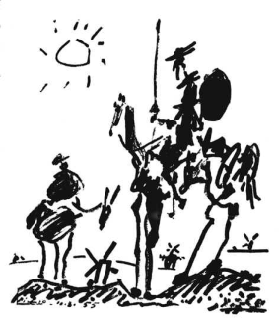
(Ex-Industry)
[97-2002] Student at Univ. of Seville
[2002-2008] Working with ISOIN, a small Software Dev. Company
[2007-*] Researcher & Lecturer at Univ. of Seville
Developer
Lead
developer
Project
Manager
Develop.
Dept.
Director

Slide 5
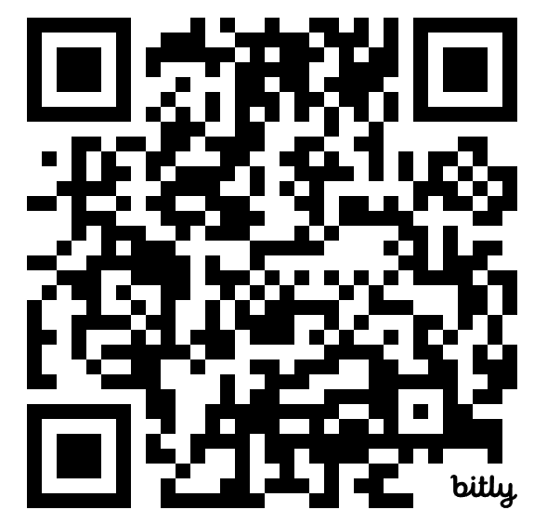
AI applications in software engineering teaching C-LEIA: AI Assistant Customer Learning Enabler
Applied as an experiment in the subject Requirements Engineering We condition a GenAI that acts as a customer with specific business needs Students interview and formalize the requirements of the application (creating a concept diagram)
Publications: Poster at ITiCSE 2025 Article in Arxiv: https://arxiv.org/abs/2503.07800

Slide 6
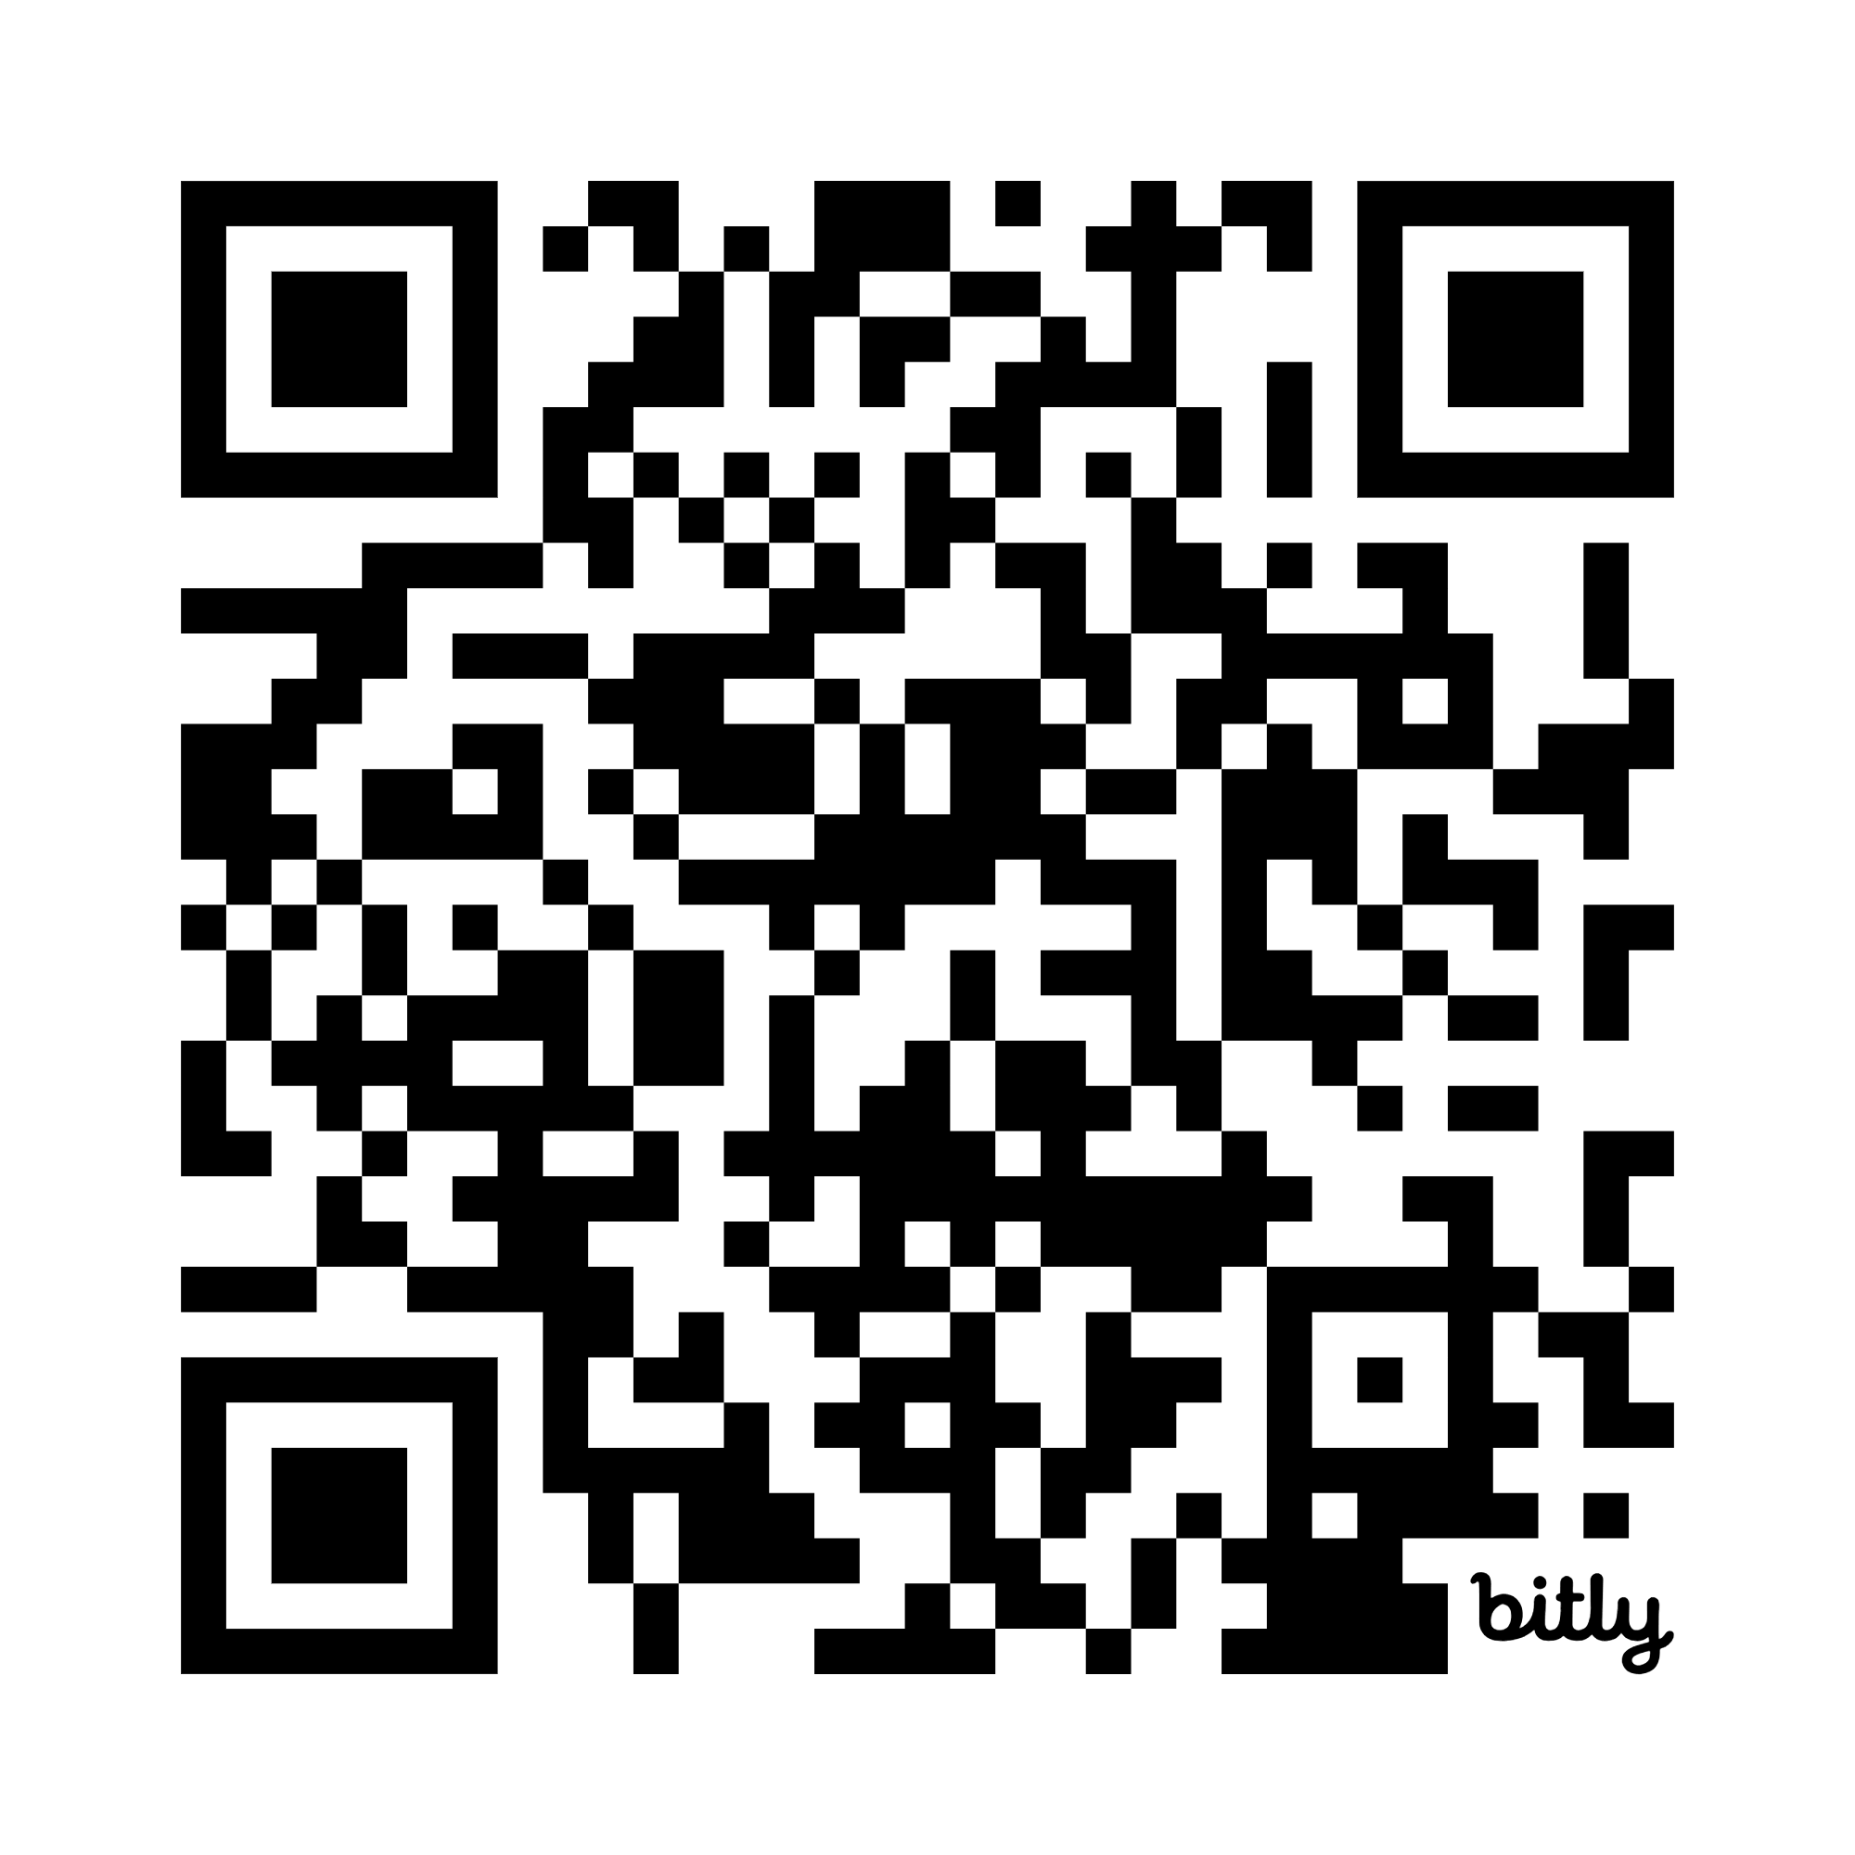
DEMO: https://bit.ly/LEIA-Example
Experiment codes:
Requirements elicitation exercise:
RMAXM6YZ16WLI46UD

Slide 7
Ongoing work:
We are working on a workbench for the design of LEIAs in different scenarios:
D-LEIA: Design LEIA that acts as peer software engineer and engages in discussions about the application of design patterns in diferent scenarios
SMW-LEIA: LEIA that acts as a scrum master wisperer (working within teams, Google meets or Zoom), providing hints for methodology adherence.
TC-LEIA: Test coverage LEIA that acts as a partner tester and provides hints to the junior programmers/testers on which tests cases and test data should they add to improve test coverage.
¿Direct arguments and discussion or socratic teaching?

Slide 8



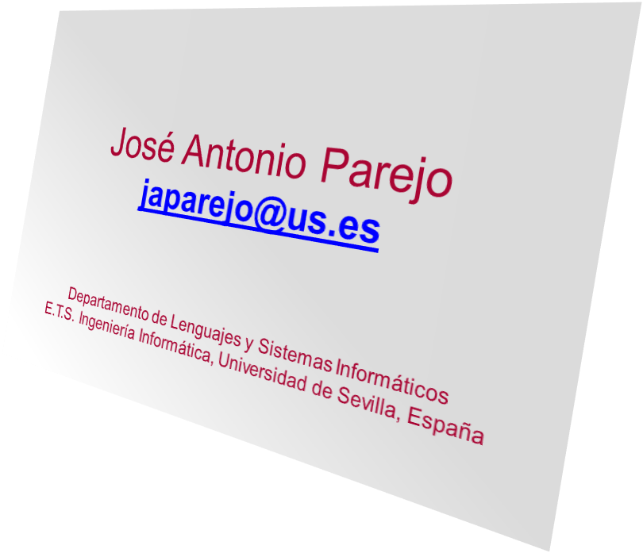

Questions? Would you like to maintain contact and use this tool in your own scenario?
Applied Software Engineering Research Group

